Slide 1

Speech Solutions: The SLP, BCBA and Parent Relationship
One model for progress
Kat Lee RDI Program Certified Consultant

Slide 2

www.autismtexas.com
kat1216@aol.com

Slide 3
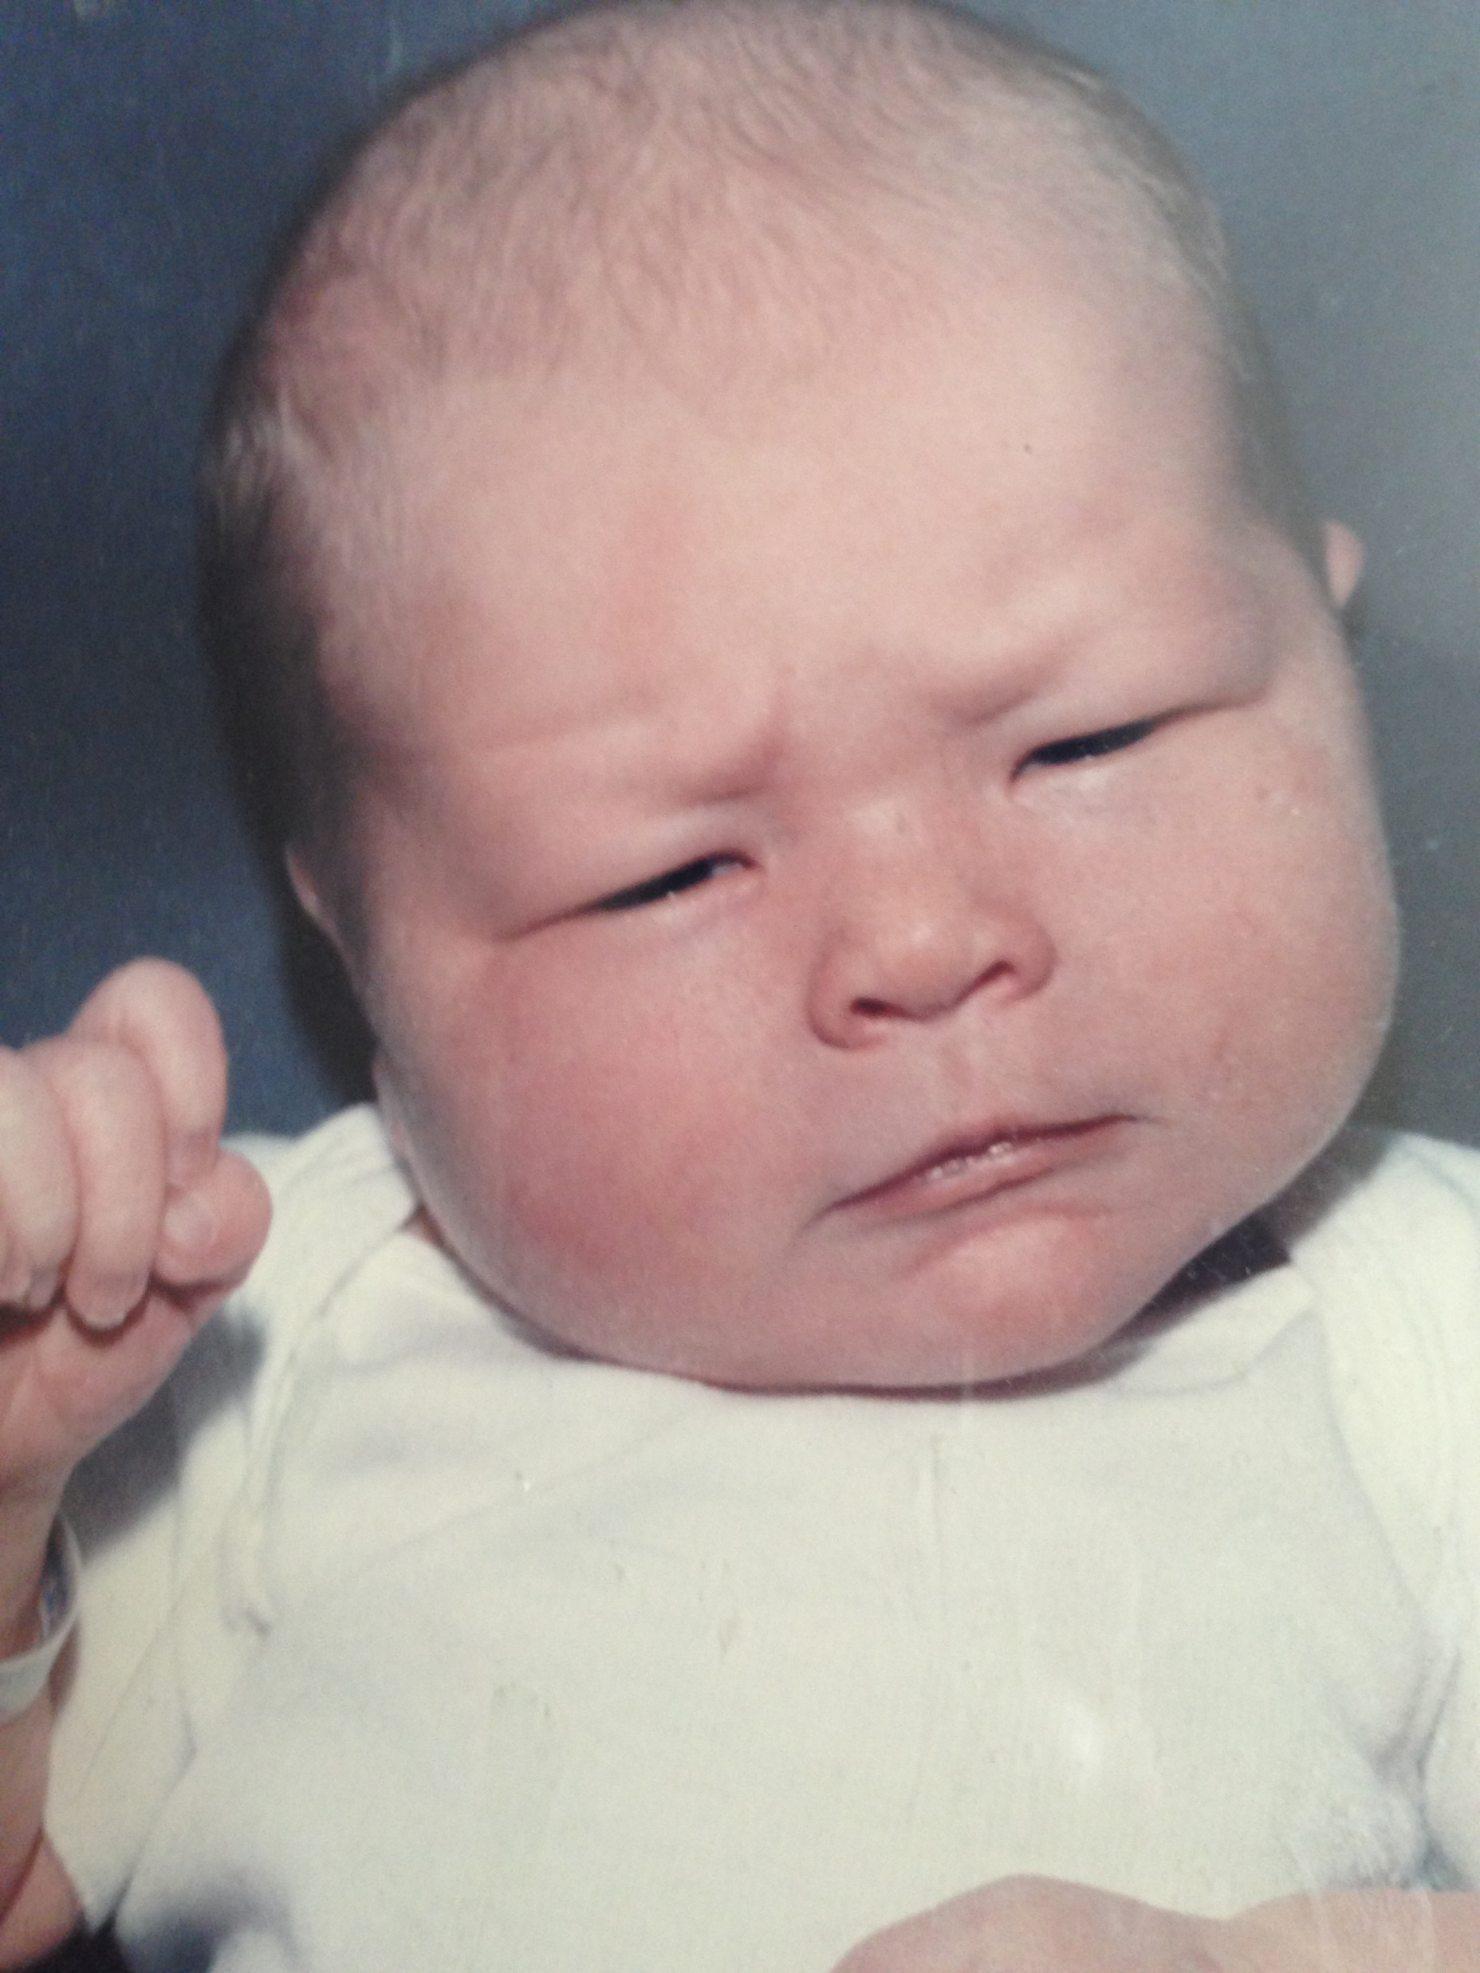
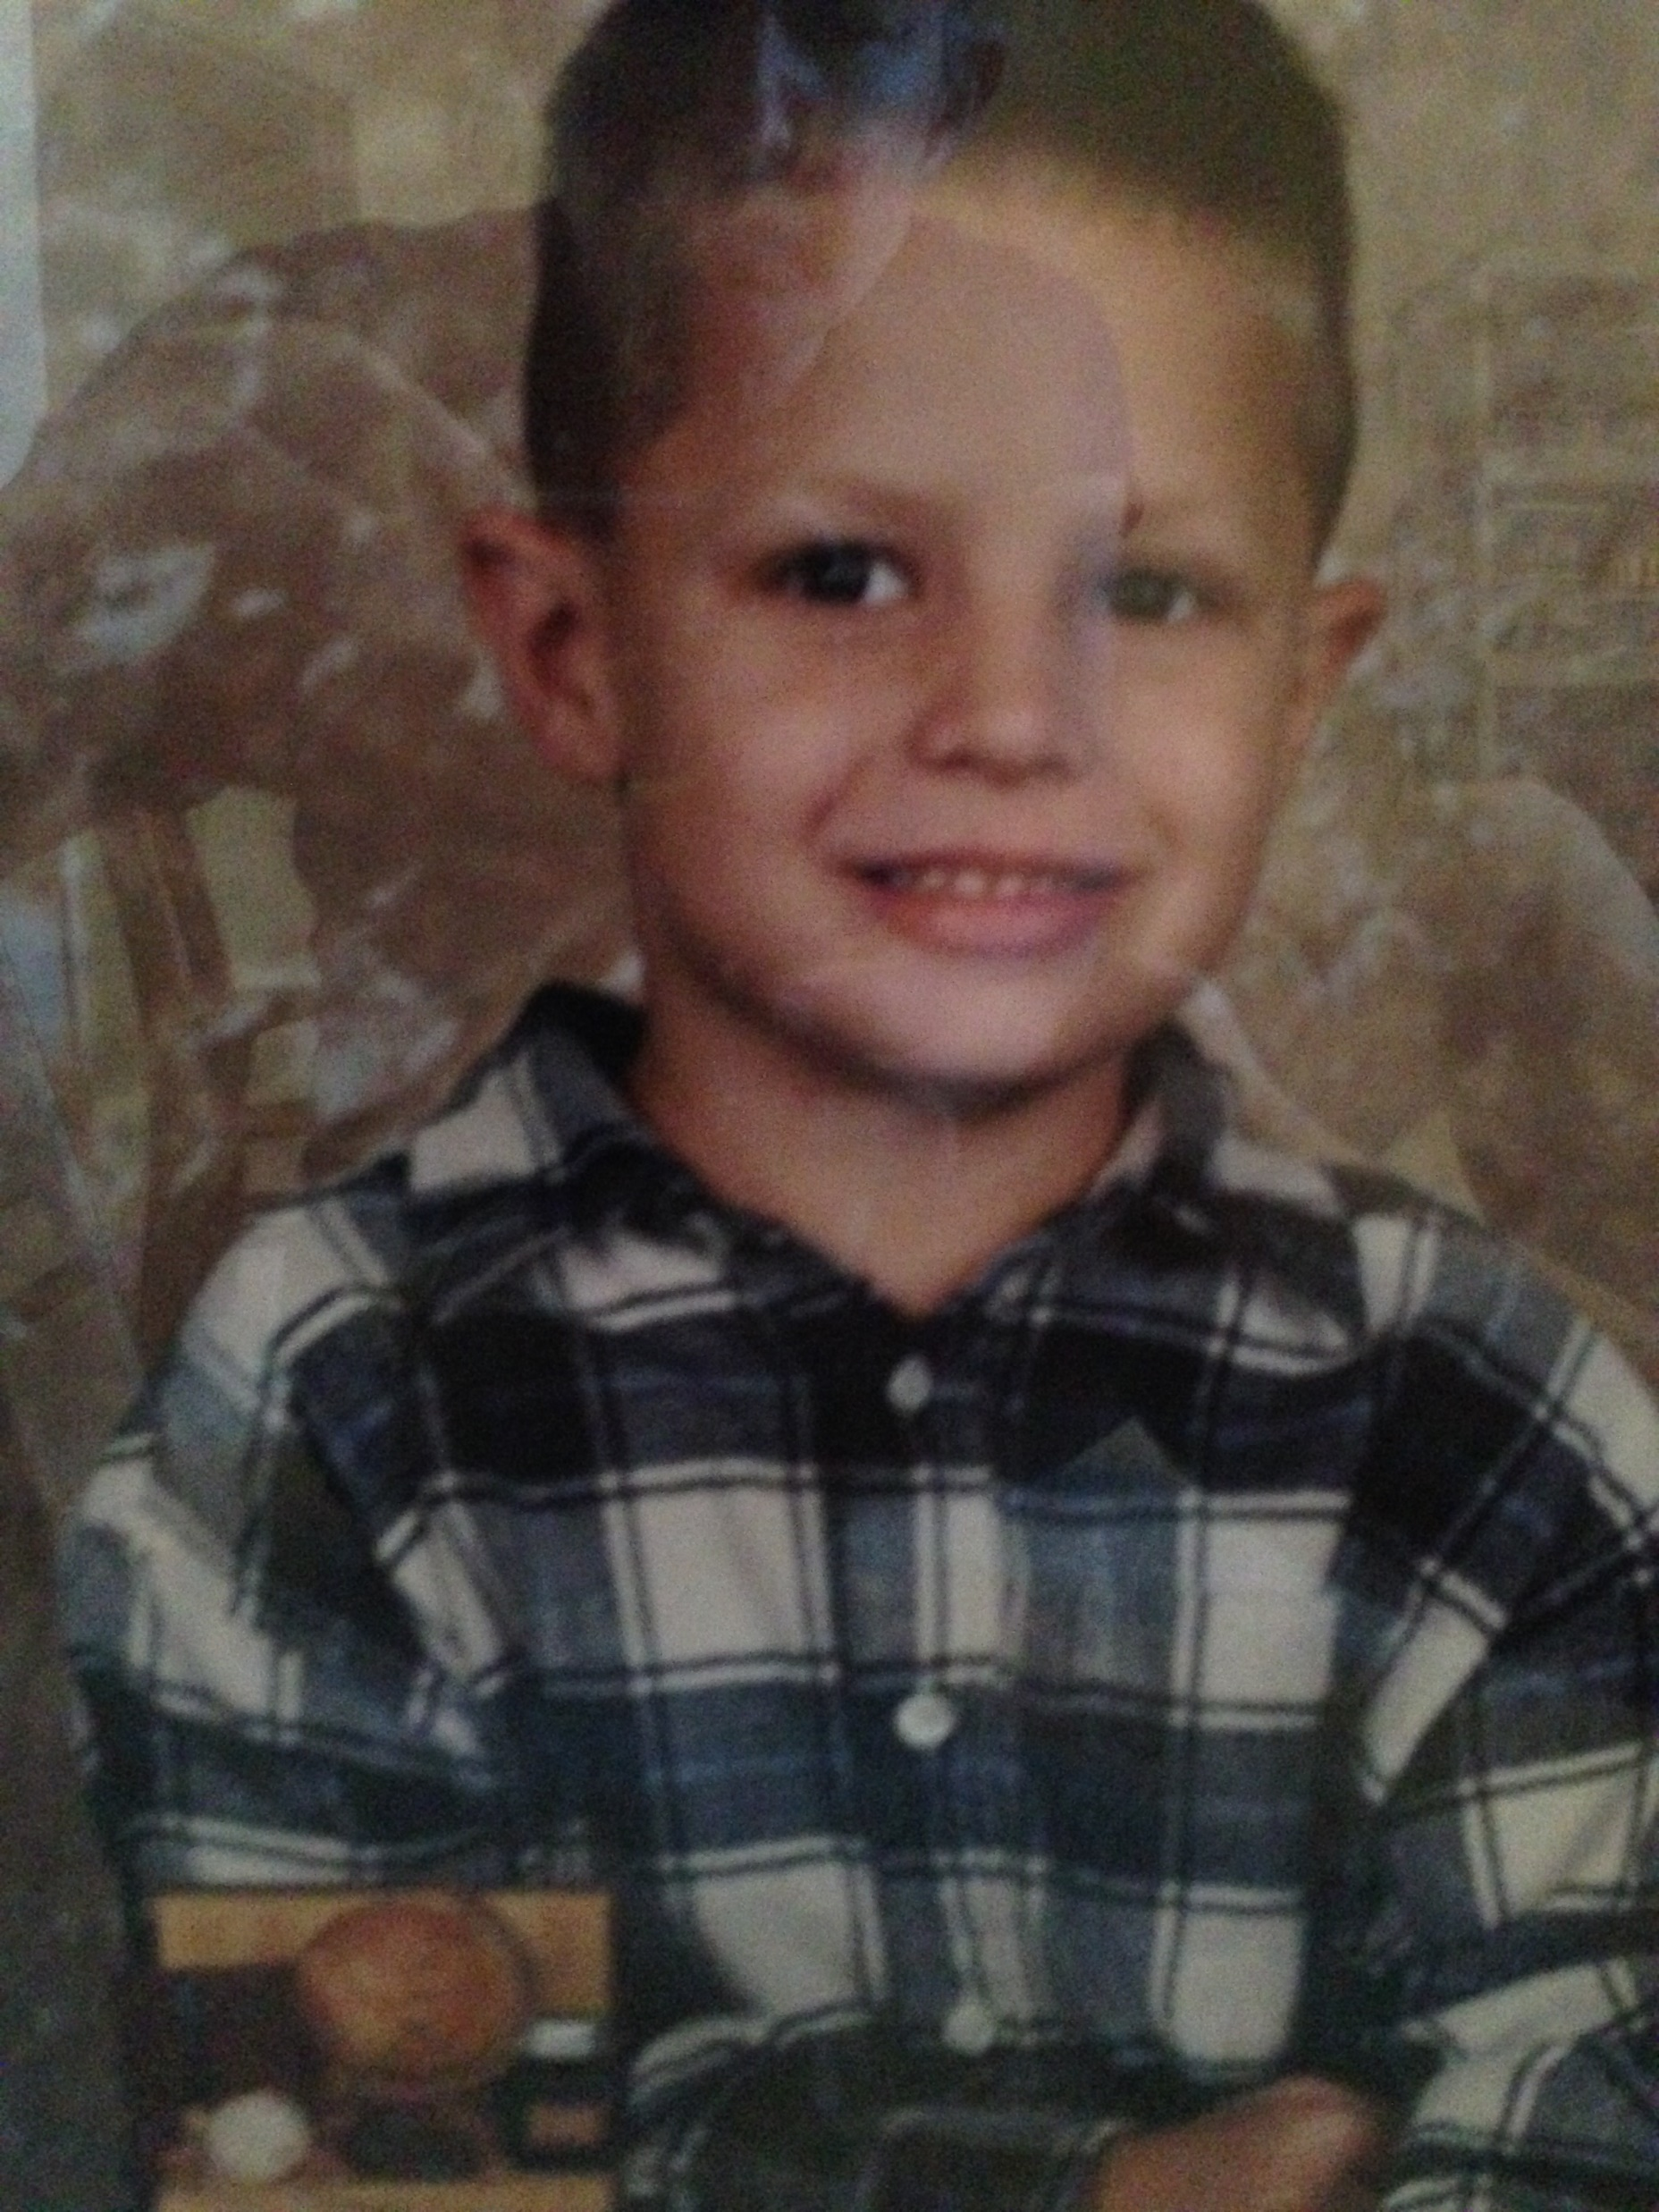

Slide 4
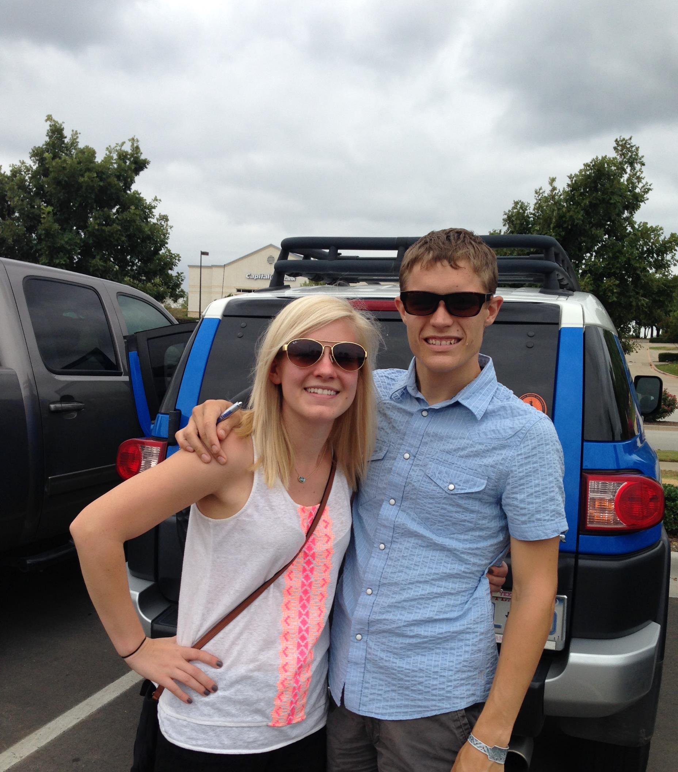
All Grown up but still on the journey

Slide 5
Not a “how to” for every one because every one’s situation is different . However, I do believe the relationship development points are key if we are to work together for the children’s best outcome

Slide 6
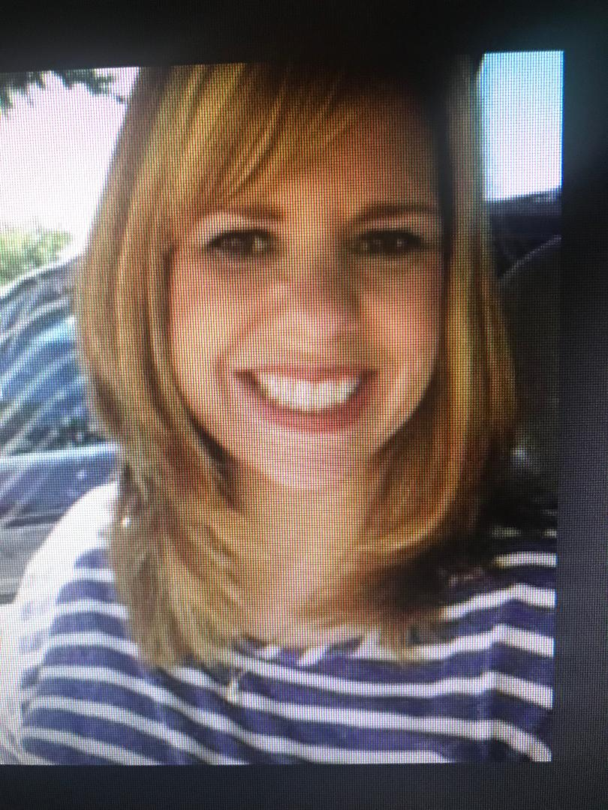
Miekka Thye
Speech/Language Pathology from Western Illinois University
Have Certificate of Clinical Competence from ASHA
Licensed by state of Texas
26 years of experience Specialize in articulation and language disorders.

Slide 7
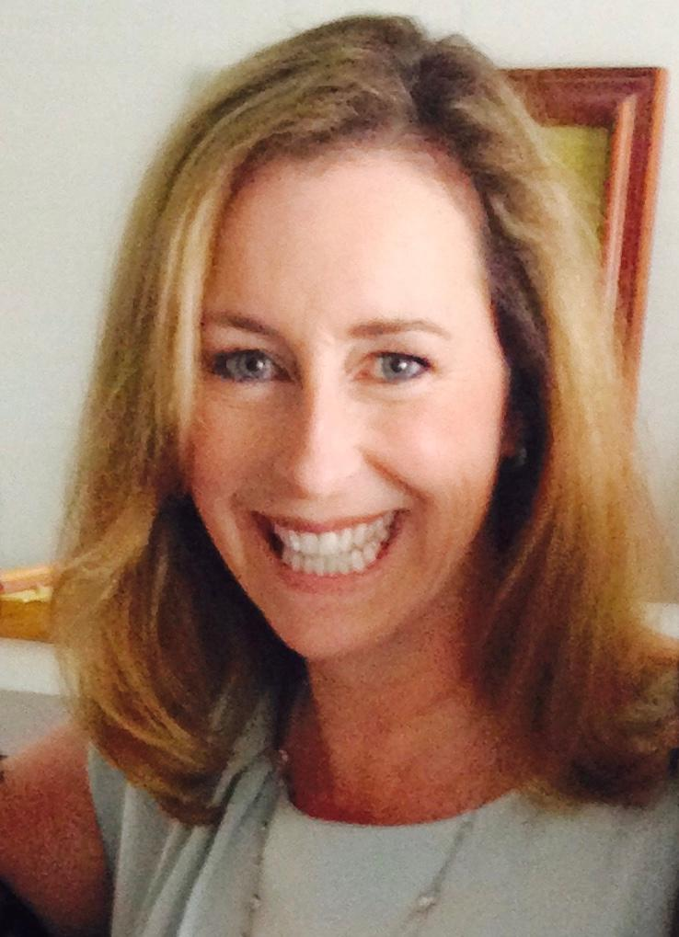
Tracy Guiou, Ph.D., BCBA-D

Slide 8
Tracy Guiou, Ph.D., BCBA-D
Dr. Guiou received her initial training in the use of learning theory and applied behavior analysis to treat children diagnosed with autism spectrum disorders from Drs. Ivar Lovaas and Jacquelyn Wynn while pursuing her undergraduate degree at UCLA. She served in a variety of clinical positions including Case Supervisor, as a research assistant on a follow-up to Dr. Lovaas' landmark 1987 study, and as a teaching assistant and guest lecturer.
She received her Ph.D at UCLA, where she was mentored by Dr. Connie Kasari, a leading reasearcher in social-emotional development of children with autism. She worked on projects examining the ability of children with autism to mask their feelings of disappointment, the relative efficacy of interventions on the social skills and playground activities of elementary-aged children with high-functioning autism, and on a follow-up to a long-term intervention targeting symbolic play and joint attention skills.
While at UCLA, Dr. Guiou also trained as a psychometrist at the UCLA Autism Evaluation Clinic under the direction of Drs. BJ Freeman and Pegeen Cronin, administering diagnostic and follow-up assessments to children and adults with a wide range of cognitive and social impairments.
Her graduate training in behavior analysis took place at California State University at Los Angeles (CSLA) under the mentorship of Dr. Barry Lowenkron and at the Florida Institute of Technology with Dr. Jose Martinez-Diaz and Tom Freeman, MS. Dr. Guiou currently holds certification as a Board Certified Behavior Analyst - Doctoral (BCBA-D).

Slide 9
Kat has been an certified Relationship Development consultant to families with children with autism for over 15 years.. She trains and supervises parents from all over the world in guiding their children with autism, helping them understand the deficits of autism and how to over come them in their relationship with their children. She also works with Alfordcreative assisting to create podcasts and webinars related to autism and relationship development for children and their families. ( youtube RDI )
Kat is also a mother whose son was diagnosed with autism 24 years ago. She has been in ongoing and training and supervision in behavior analytic work for her son since diagnosis and her family has been under the oversight of Tracy Guiou, Ph.D., BCBA-D for almost 20 years.

Slide 10
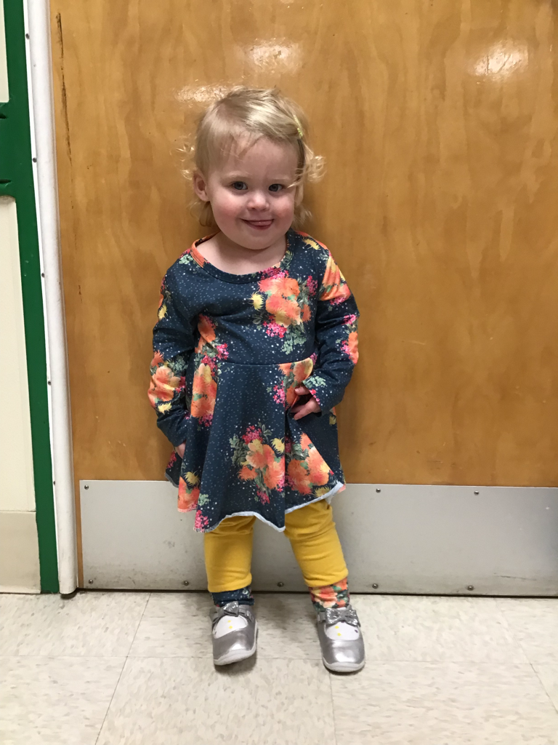
Grandbaby

Slide 11
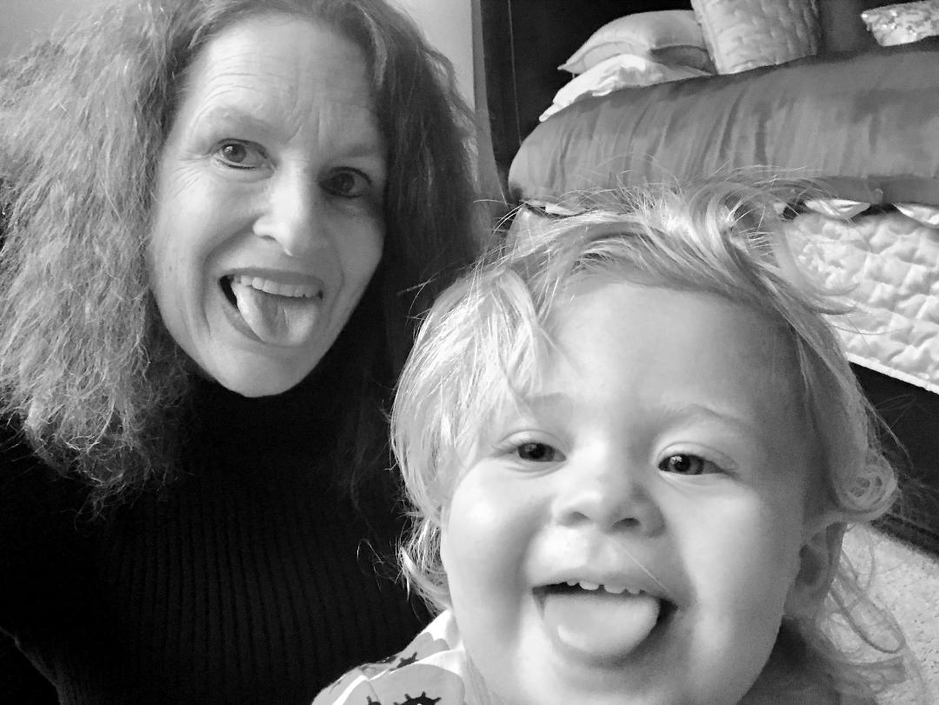
Uh Oh

Slide 12
This is a step beyond referring in or basic consultation. Several steps beyond.

Slide 13
Project Based Collaboration:
Our Example Project Today: Conversation: Goal to develop both reciprocal and spontaneous authentic conversational skills in a low verbal student who has the foundations for further communication. Our purpose is not only to assist the student in becoming competent in conversation but to feel comfortable in interactions to enable genuine authentic exchanges with social partners. Note: Our presentation is not on this program but on how the professionals collaborated with the assistance and participation of the parents.

Slide 14

Key Elements
Competence in area of expertise
Respect for others expertise
Interest in learning more and a conviction there is more to learn
Willingness to learn from others
Ability to handle direct feedback/ thoughts/ critique at a professional level
Enjoyment of collaboration
Sharing ownership of healing
Professional culture
Continuity

Slide 15
High Expectations – combined with understanding of work and commitment that expectation entails

Slide 16
Parent
SLP
BCBA

Slide 17
The Triangle
Parent
We each represent a point on the triangle
BCBA
SLP

Slide 18
Before we go on: The Graph could look like this
Stud/Parent
BCBA
Staff
OT
SLP
Staff
Staff

Slide 20
SLP Role
Focus on articulation(Therapy)/ articulation reports
Focus on conversation( Therapy)( own conversations with student) self analysis and reports
Review of other staff work with student
Data Review:
Question answering accuracy/ form/ content
Question asking accuracy / form / content
Conversation reviews( scripts) for / reports
All reports go through parent to BCBA

Slide 21
From Tracy: SLP important indicator of linguistic progress (e.g. targets follow developmental norms - specific targets and how generalize from trials to conversation)

Slide 22
BCBA Role
Construct current goals in collaboration with parent and reports from SLP and other participants
Listen to/ read( scripts provided) multiple conversations from conversational partners
Update/ revise procedures of conversations based on progress or lack there of
Monitor additional adjunct conversational markers such as question responding/ question asking
Review all reports from SLP and other participants
Communicate via in person meeting, online and additional informational supplied to parent via report.

Slide 23
BCBA must be aware of typical language development, social/emotional development and a function-based approach to intervention

Slide 24
Let’s look at some examples of work done

Slide 25
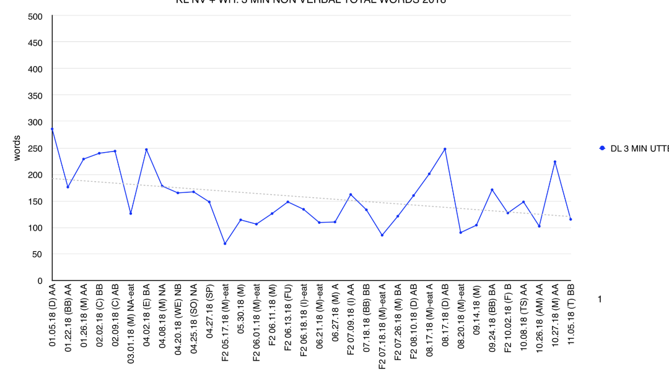
Example of graph for interpretation

Slide 26
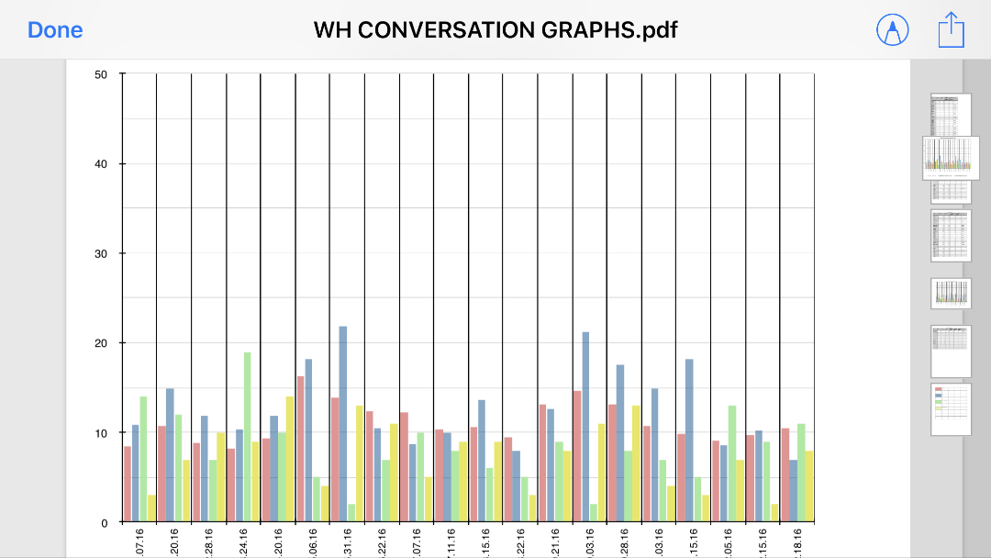
Another Graph

Slide 27
Scripts and other data analysis

Slide 28


Parent Responsibilities
Facilitate communication between all parties concerned
Organize data collection, review times, meetings etc ( i.e. coordination)
Plan, attend and participate in meetings
Implement/or assist in carry through of BCBA and SLP goals
Create a professional , safe atmosphere of respect
Coordinate interactions between all parties concerned
Educate , inform and implement

Slide 29
Obstacles/ Discussion points
Time
Administrative continuity
Consistency
Accurate Data Collection
We go more than a Me go
Note: involved ability for all parties to work together as professionals including parents

Slide 30
How long does the collaboration continue?

Slide 31
Why?

Slide 32
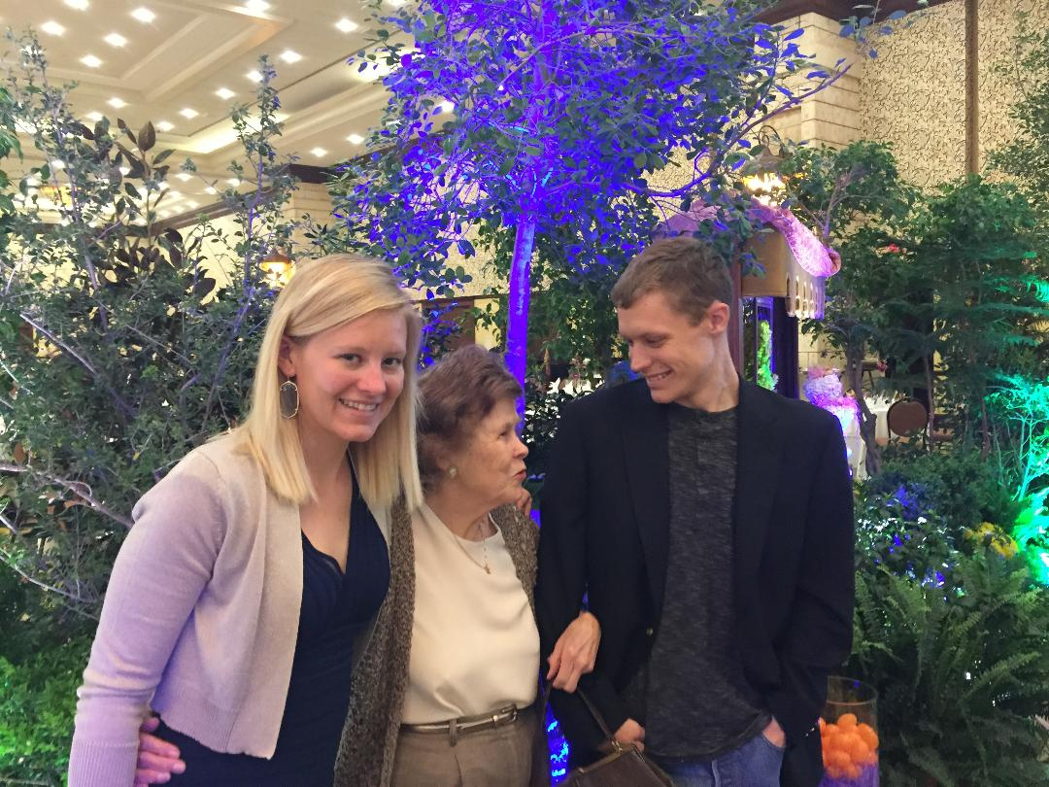
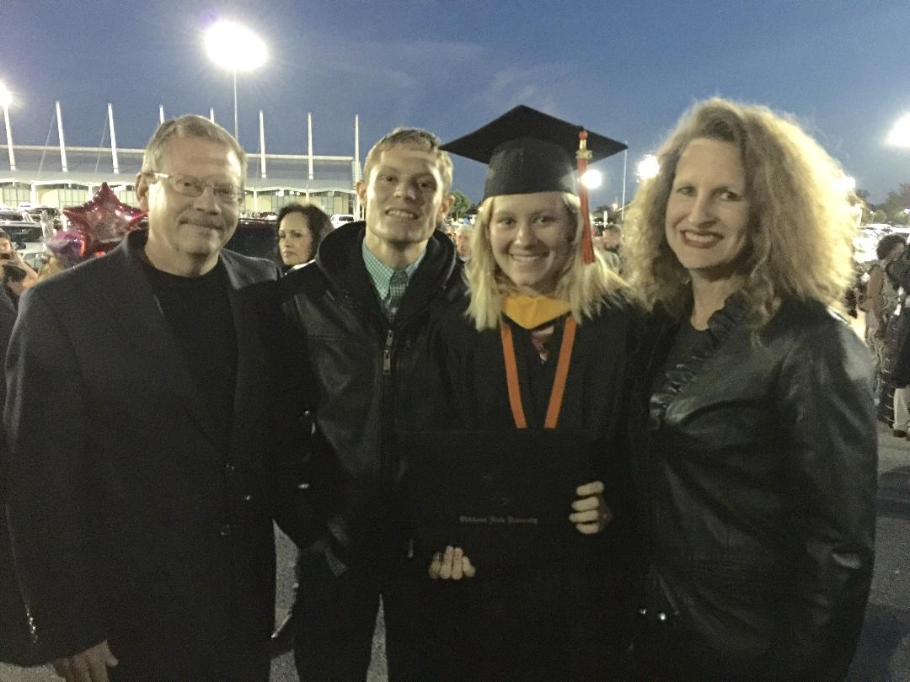
To live his best life possible

Slide 33

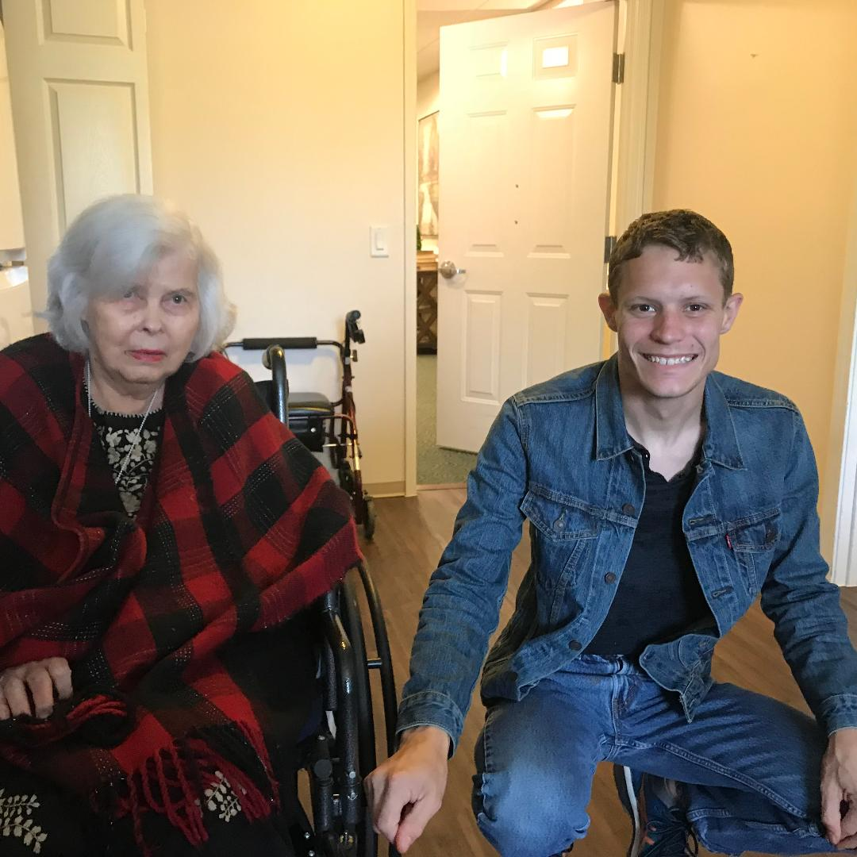
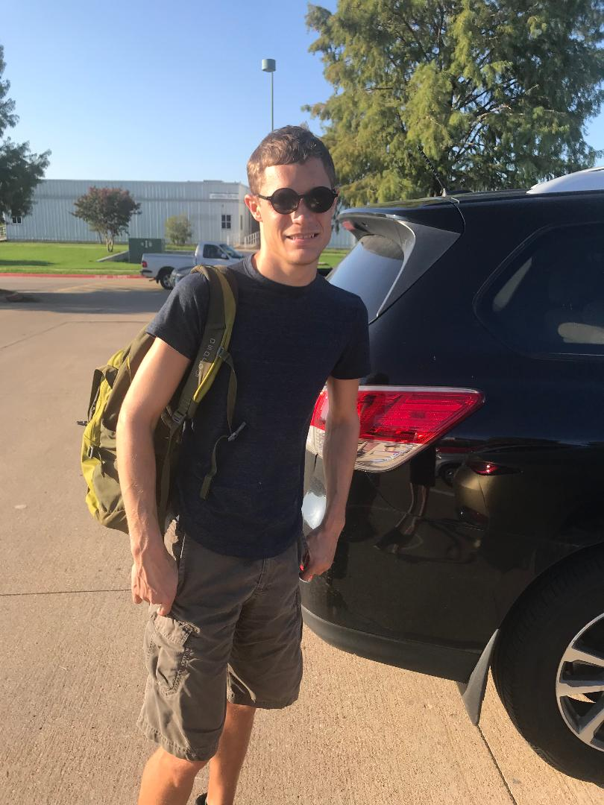
To live best life possible

Slide 34
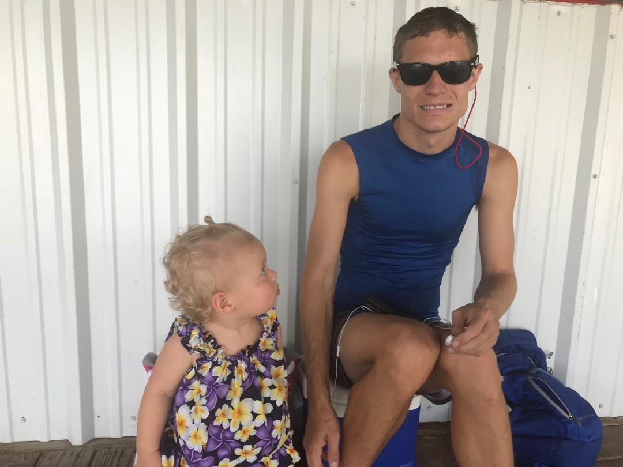
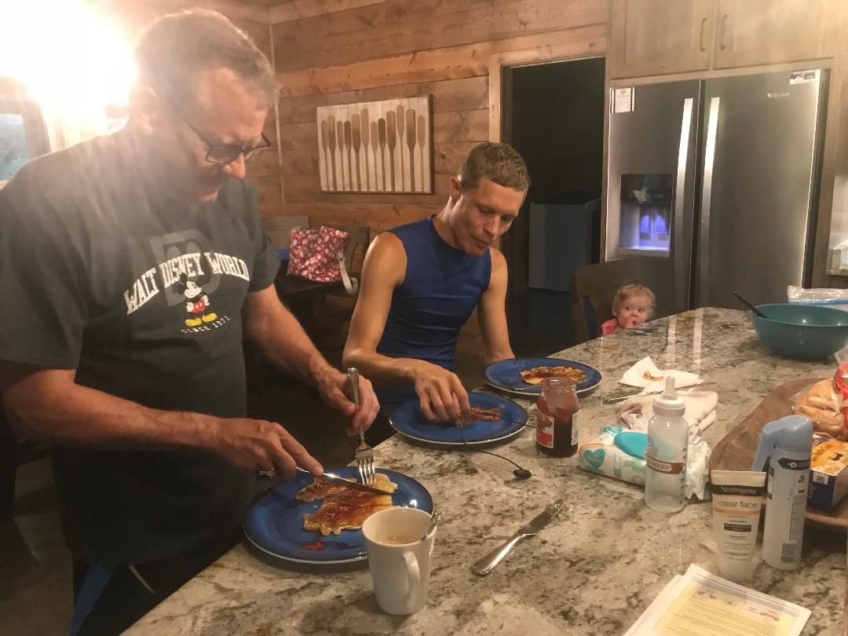
Living Life

